Slide 1
Soccer’s Continuous Problem Quantifying the Value of Individual Talent In A Largely, Unquantifiable Game
By Daniel Jurado
Data Science Fellow @ Thinkful

Slide 2

Using Empathy To Understand Statistics To Aid Our Decision Making Process

Slide 3
Starting with some Empathy
Today we are all Soccer Club Owners
Lower tier club
Not really competitive
We are simply in the ‘Business’ of running a Soccer Club

Slide 4
The Business Of Soccer
Identify Undervalued Talent
Develop said talent
Hope to Sell that talent for more money than we invested in them.

Slide 5
Identifying Talent Today
People in soccer have historically paid little attention to statistics
“the only way to judge players is to see them in action.”
In reality, little-to-no availability of Individual Player Statistics

Slide 6
What else would you expect from a game that is essentially one long continuous event?

Slide 7
Discrete Games Embracing the Statistical Renaissance
Collection of Discrete Events with Recordable Outcomes
Football and Quarterback Rating
Baseball and On-base Percentage
Basketball and Player Efficiency Rating
One Number to Rule Them

Slide 8
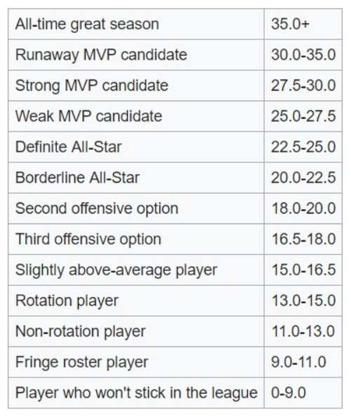
NBA Player Efficiency Rating

Slide 9
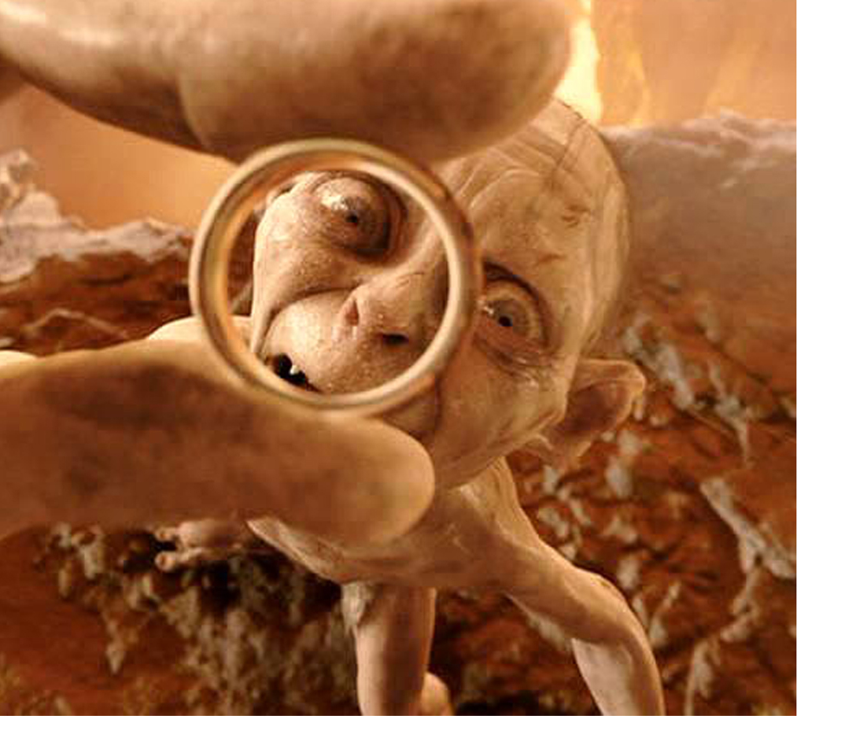
Can we derive Soccer’s One Statistic to Rule Them All?!

Slide 10

In Search for an Answer….

Slide 11
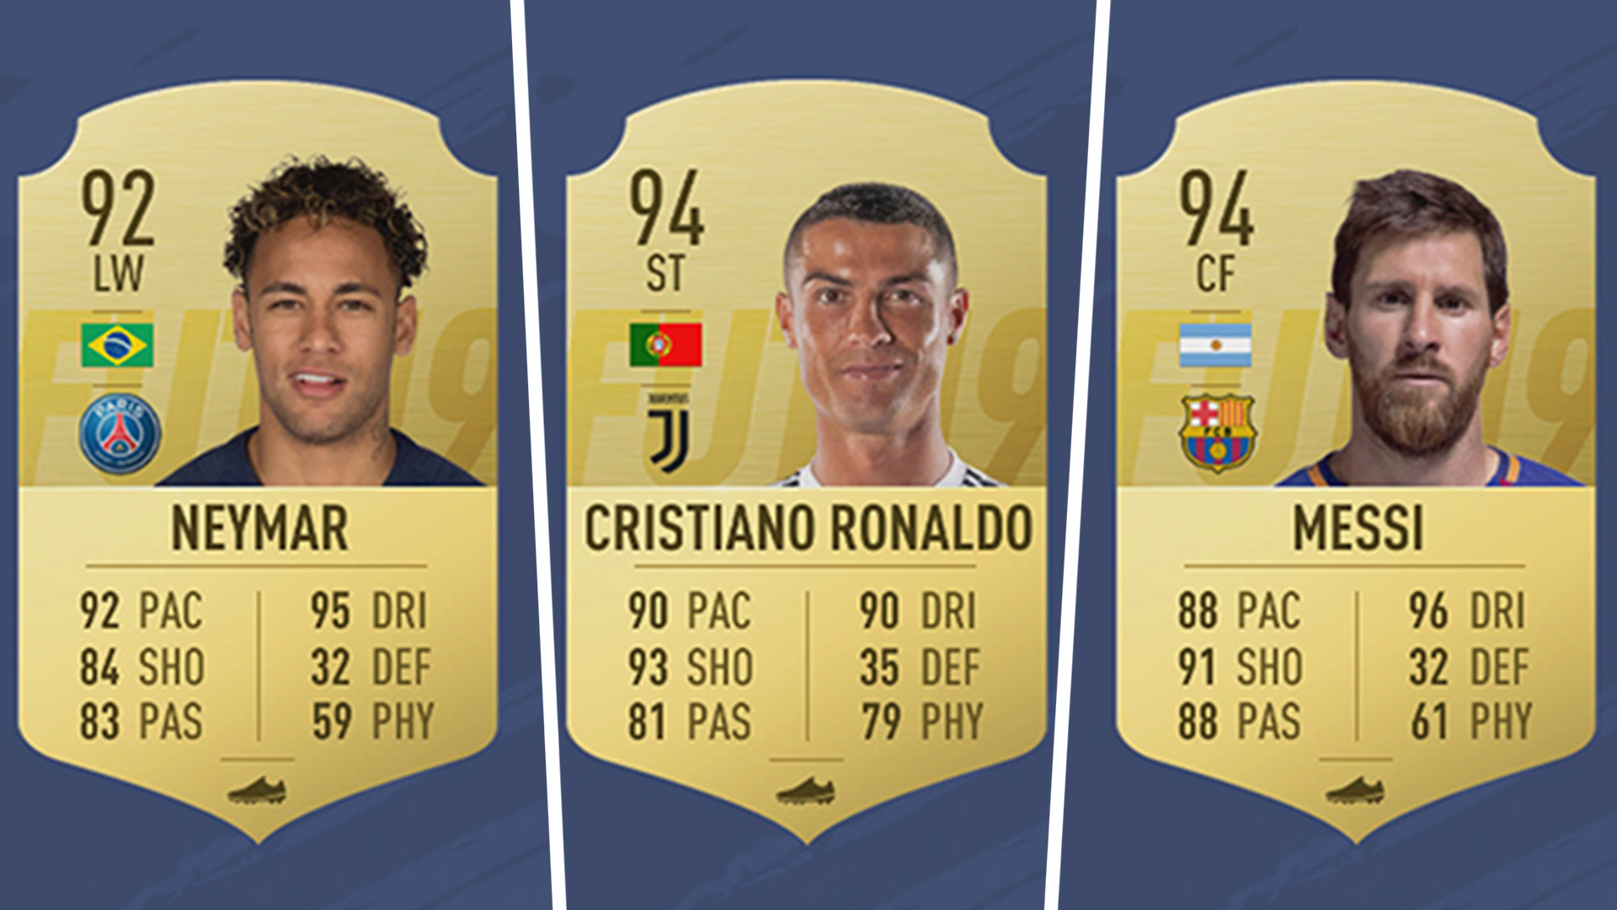
FIFA – Overall Player Rating

Slide 12
FIFA Quantifies their Subjectivity… …so that their Game Simulation reflects reality as best as possible. Can this help us: 1) Identify Undervalued Talent 2) Better Develop our Talent

Slide 13
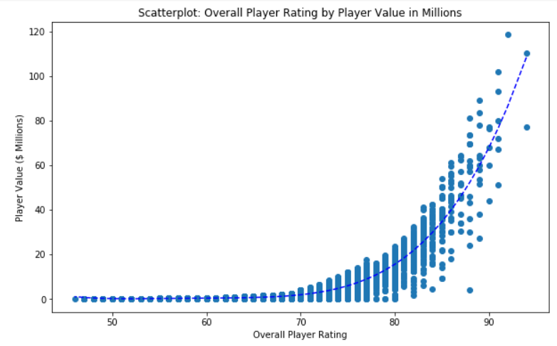
Problem #1 – Identifying Undervalued Talent
Player Value vs Overall Player Rating (OPR)
A Clear Relationship!!!

Slide 14
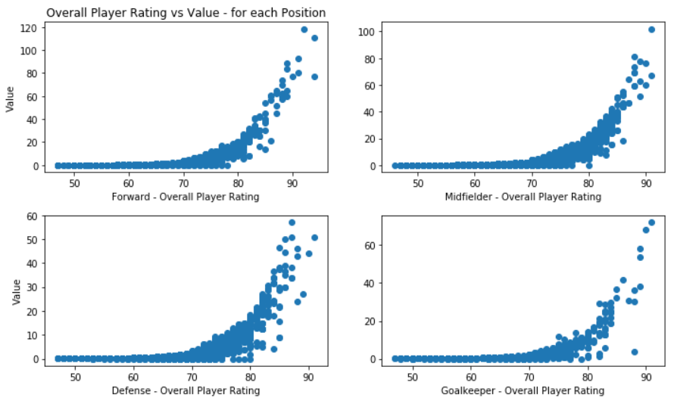
Plot by Position
r² = .92
r² = .91
r² = .88
r² = .85

Slide 15
As a Club Owner so far…
We can support scouting and acquisition initiatives
Having a concrete value to look for, complimenting our 'subjective feeling' of a player.
Poaching Players Below the Mean!?

Slide 16
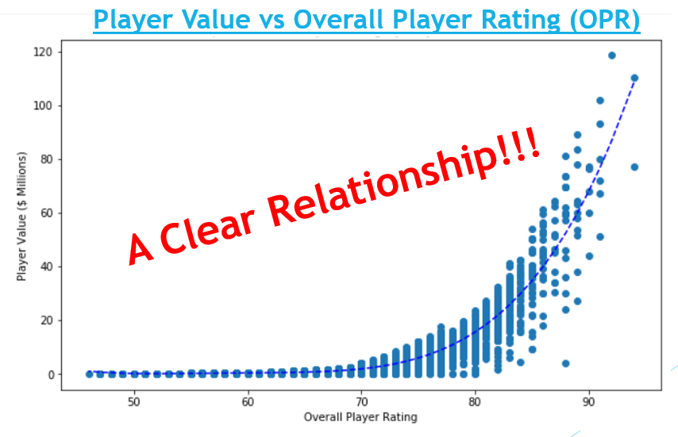
Let’s Now Take This Further: Given a Clear Relationship of Value vs OPR.. …if we can determine what exactly influences OPR… …then we will know exactly what we need to focus on to best develop our players to raise their value.

Slide 17
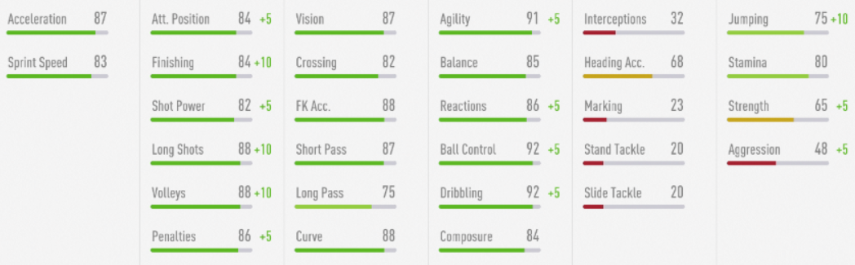
Problem #2: Optimal Player Development
FIFA has Skill Attributes for All Players

Slide 18
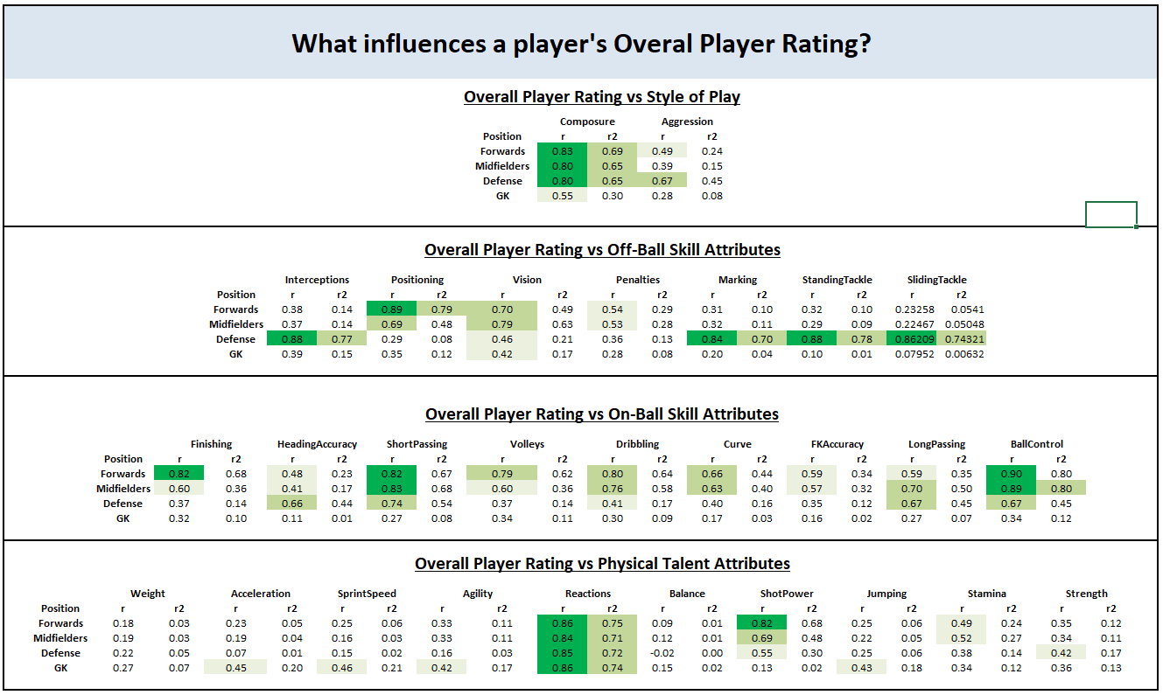
Player Value vs Skill - Correlations and Variance

Slide 19
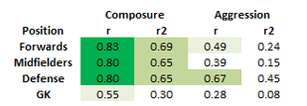
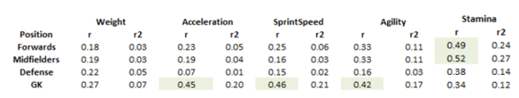
Example of the Insights we gain:
Composure is CRITICAL maybe we should have a Sports Psychologist on staff
Goalkeepers should be focusing on Acceleration, Sprint Speed, and Agility
Stamina is more important for Forwards and Midfielders

